Slide 1
Prototype Iteration & Feedback
Dr. Glory Aguzman, S.Sos, M.M., CDMS, CCP

Slide 2
Subtopics
Student Video Interview Presentation
Product or Service Demonstration
Create a Feedback Grid
Present the Feedback Grid
Prototype Iteration and Feedback Session
Design Iteration
Student Activities
Next Session Preparation

Slide 3
Acknowledgement
Michael Lewrick, Patric Link, Larry Leifer (2018) The Design Thinking Playbook – Mindful Digital Transformation of teams, products, services, Businesses And Ecosystems, Wiley, P121-123

Slide 4
Learning Outcome
LO2: Test the prototype to assess business potential.

Slide 5
Document Result
It is of vital importance to document the results. In so doing, we actively observe how users use (and misuse!) what we have given them.
We do not immediately correct what our test participation is doing.
Photos or video recordings are very suitable for documentation.
Digital tools make documentation easier but be careful not to forget to use them.

Slide 6
Create a Feedback Grid
This method can be easily applied to groups consisting of two to over 100 people. The simple structure helps to formulate constructive feedback.
Giving feedback is one thing; receiving feedback is quite another. When we receive feedback, we should see it as a gift and express our gratitude.
We listen to the feedback and do not have to answer in any way. In addition, we should avoid justifying ourselves and simply listen Carefully.
At the end, we ask again if we haven’t understood something or if something is still unclear to us.

Slide 7
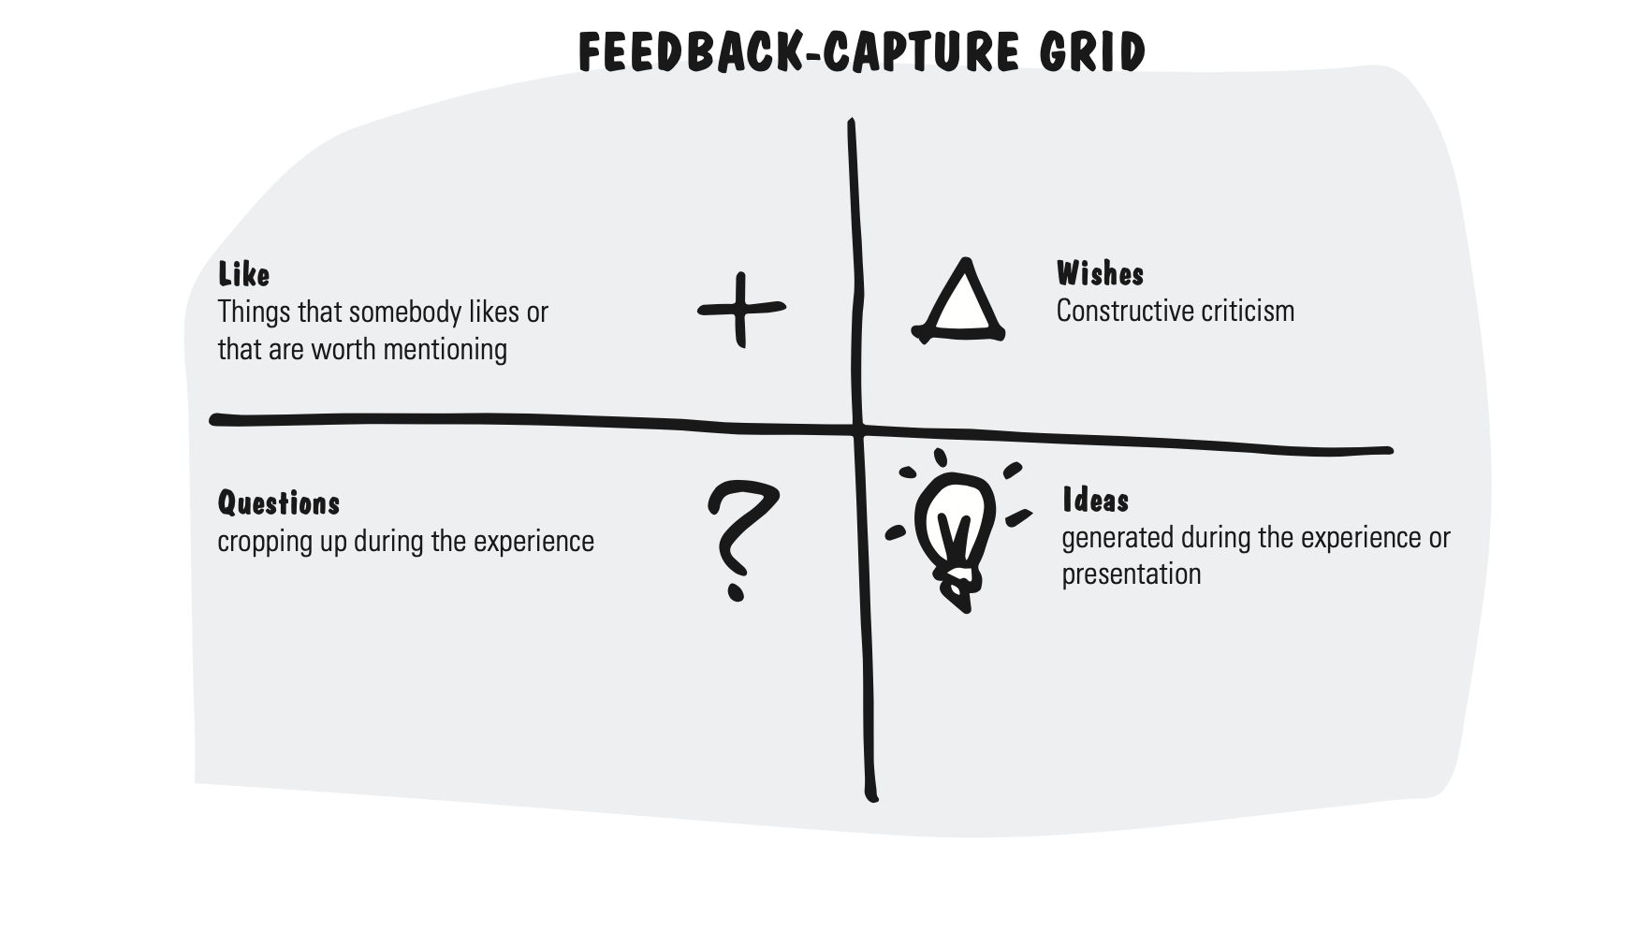
Present the Feedback Grid
We use the grid to capture the feedback systematically and deliberately in four main areas.
What do we like?
What wishes do we have?
What questions have come up?
Which initial ideas and solutions have we found?
Filling in the four quadrants is pretty easy: We write each piece of user feedback in the appropriate quadrant category.
As an alternative, we can choose the following areas for the four quadrants: “I like…,” “I wish…,” “What if…,” and “What is the benefit?”

Slide 8
Prototype Iteration and Feedback Session
Engage with the Prototype: explore, and test all its features to see how it works. Don’t worry about breaking it — this is how you learn and find issues..
Provide Feedback: Talk about the design, how easy it was to use, and whether it did what you expected. Suggest ways to make it better..
Discuss Observations: Work in groups, talk about your experiences, and listen toothers’ opinions. You might see things differently or learn something new from their perspective.
Reflect and Document: Summarize what worked well, what didn’t, and what could be improved. This helps the design team understand your experiences clearly..
Support Iteration: Test the updated version after changes are made and check ithe new design solves previous problems or creates new ones.

Slide 9
Design Iteration
is the process of creating, testing, evaluating, and refining a design multiple times to make it better.
Each version (or “iteration”) builds on what was learned from the previous one.

Slide 10
Student Activities
Prototyping Testing
Create Feedback Grid
Prototype Iteration and Feedback Session
Design Iteration

Slide 11
Next Session Preparation
Student Watch BMC Video Before Next Session:
BMC Overview: https://youtu.be/C0LqBd7grrk
BMC Customer Segment: https://youtu.be/L0NoA-YkLlg
BMC Value Proposition: https://youtu.be/sKRapoUwPh4
BMC Channel: https://youtu.be/4lqxRVsQtqE
BMC Customer Relationship: https://youtu.be/EbWOfEEAfzA
BMC Revenue Stream: https://youtu.be/YF-mrDJck6Y
BMC Key Resources: https://youtu.be/czx2-3WP4uc
BMC Key Activities:https://www.youtube.com/watch?v=8v1it_OXkqU
BMC Key Partnership: https://youtu.be/YeY0dajzXII
BMC Cost Structure: https://youtu.be/47Ris1zZjoY
Student Learn Business Model Canvas
Students Will Create Business Model Canvas

Slide 12
REFERENCES
Michael Lewrick, Patric Link, Larry Leifer (2018) The Design Thinking Playbook – Mindful Digital Transformation of teams, products, services, Businesses And Ecosystems, Wiley

